Slide 1



(Formerly know as Techjivaa Software Pvt. Ltd.)
HEALTH IT PLATFORM IMPLEMENTATION PROPOSAL FROM MEDIMAZE TO
HONORABLE HEALTH MINISTER, MINISTRY OF HEALTH, UTTARAKHAND

Slide 2


Introduction
About Us
Our Capabilities
Statewide Solution & Experience (J&K, Others)
Benefits to J & K
Proposed Solution For Uttarakhand
Overview
Details
Benefits to Uttarakhand State
Medimaze Proposal to Ministry of Health, Uttarakhand
AGENDA

Slide 3
About Us
Established in 2016.
Founders having experience of more than cumulative 120+ Man Years across Healthcare Solutions
Expertise in Healthcare Industry and FinTech Industry
Successful implementation of JK e-SAHAJ HMIS in Jammu & Kashmir in 500+ locations.
Offering services for over 20 districts In India.
Design & Development services for fintech to South Africa.
Maintaining cloud ERP for healthcare client with 24x7 technical support.
Managing Tele-radiology operations for one of the largest Diagnostic Companies in India
Services Offered :
IT Services
Healthcare
Tele-reporting

Slide 4
Medimaze Capabilities
Medimaze capabilities can provide actionable insights to Healthcare Providers in Public Sector and better understand
the impact of their care processes across the continuum of care – Ensuring End To End Healthcare IT Platform
Hospital Information
Management System
Central Supply Chain
Management (Inventory & Pharmacy)
Mobile App – Doctors, Pharmacists, Patients
Volume
Leakage Analytics
EMR/EHR/PHR
Radiology Information
System - PACS
Portals –
Patients, Doctors
KRA & KPI
Management
Tele-Radiology
Tele Pathology
Provider Benchmarking of Hospitals
Population
Health Management
Laboratory Information Management System
Human Recourse
Management System
Cloud Solutions
& Services
Medical College
Management System

Slide 5







Value Generated through HealthTech Solutions
Connected PHC’s, CHC’s, DHS on a single web based platform
Online Dashboards
Actionable intelligence
Connected Hospitals, Medical Colleges, Diagnostics Centers
Compliant with NDHM with ABDM Integrations
Integrated Online Healthcare Services
Mobile ready – Ambulatory access

Slide 6


Case Study Value Created: Implemented HIMS Solution for Jammu & Kashmir

Slide 7
Health System Implementation & Integration for UT of J & K
100,000+ Patients
The National Health Mission, Government of J&K has engaged us to transform the current state of ICT and its applications for improving Healthcare Service Delivery
8 Modules
OS – Linux, VM
Db – My SQL
Technology – Java, Angular
billion
Proposed 1000+ Hospitals, CHC’s & PHC’s Live
Proposed Sites:
Medical college and Hospital - 20
Super Specialty Hospital – 20
District Hospital – 10
CHC’s – 500+
Primary Health Centre – 500+
02 Mobile Apps
40+
Support
Staff
500+ Physical Sites
100+ Reports
30 Standard Operating Procedures
4 Central Government System Integrations
Continual Evolution
5+ Enhancements per month

Slide 8
Problem Statement - HIMS Implementation, Challenges & Solutions Provided to J & K
Digital Transformation – HMIS in UT of J&K:
Client challenges :
Data Collection & Duplication (Hospital Staff) - paper-based, time consuming and tedious, which results in delay in aggregating and reporting of same data across different levels including MCI and Audits.
Lack of timely accurate information and analytic tools for decision making, Lack of alerts for timely action, Use of data for planning & optimization of resources, Lack of timely availability of drugs, vaccines, and other consumables
Patients/ Citizens - Long waiting time in queues, Lack of proper instructions,
Medimaze Solution:
Unique Patient ID: Every patient is given a unique “PRN” for lifetime. All availed services and records are attached with the same ID for tracking patients and ease of processing repeat visits to the hospital.
Dashboard: Executive dashboards for key stakeholders for live statistics from the hospital including patient count, financial revenue generated, etc.
Output: Complete patient records, Lower turn-around-time per patient for better experience, automation of processes for simplified reports, audit and daily functional purposes
Obtained knowledge of the existing systems (applications, infrastructure) and operations of existing application suite from the incumbent operator.
Upgraded the underlying software platform needed to host application suite, as necessary.
Identify and broadcast preventive health Care / Early detection interventions, assess quality of services, fraud detection and prevention.
UIDAI integration for better patient identification.

Slide 9
Value Created By HIMS - Benefits to J & K
Benefits to UT of J&K & Functional Enhancements Due to HIMS :
For Government
For Patient
For Hospitals
Complaint Platform integrated to ABDM
Integrated with NIC Platform
Online Real Time Dashboards
Online Hospital Ratings
Real time Patient Feedbacks Available
Medicines Stock Tracking
All Facilities On One Platform - Delivered a HIMS robust Solution suite compatible with a new age Cloud environment.
Online e-Prescription implemented – With Real Time SMS
Long Queues Sorted: Token number display for Queue Management
Easy Access To Healthcare : Online Appointments & OPD registration
Location of nearby Blood Bank with current stock using mobile app
Online MIS: Report Generation
TAT improvement of key clinical and non-clinical process
Provide better and easier interfaces to the Hospital and Health Canter Users to reduce the scope for errors in submission and processing of pre-authorization requests and claims.
Live Apps access to Doctors, Providers & Patients
Hospitals ratings available online
Patient feedback available online
HIMS Suite Connected all Healthcare provider facilities together to one cloud – Ensuring unique patient identifications across facilities

Slide 10
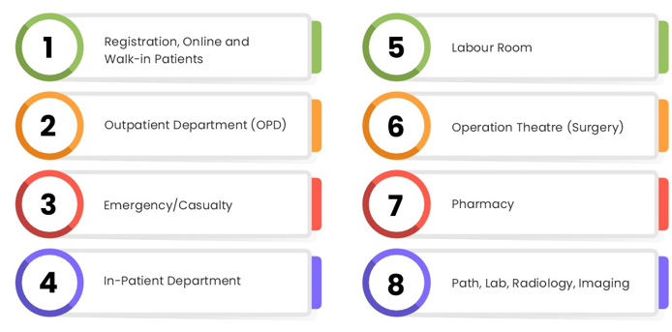
Modules Offered & Live at J & K
Configuration and Deployment of HIMS Solution in Hospitals
Value Added Services
1. SMS Integration
- Visit details
- Prescription Details
2. Feedback Mechanism- Integration with Mera Aspataal
3. Mobile Application for Doctors & Pharmacists

Slide 11
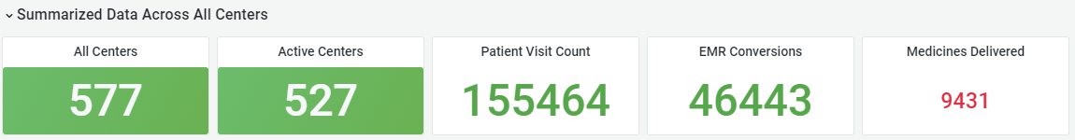
Current Status of J & K Project
Data derived from dashboard (past seven days)
Total Centre in Jammu and Kashmir UT - 577+
Total active centres - 527+
Patient visit count of last 7 days - 1,55,464 + Patients
EMR conversions of last 7 days - 46,443 + Patients
Medicines delivered through portal - 9,431 + Patients
Centres with no registrations - 50 +

Slide 12


Other Case Studies Value Created

Slide 13
Together, We have delivered on significant aspects of client’s requirements
1 Implementation/customization of HIMS/EMR
4. Third Party Integration
Sir Dorabji Tata Trust - Implementation of HIMS, TeleMedicine
SMBT Group of Medical College (11) - Implementation of DiCOM PACS, HIMS Software
Chhatrapati Shivaji Memorial Hospital, Kalwa, Thane - Implementation of ICT based HMIS
Sir Dorabji Tata Trust – E-Sanjivani Integration across all Tata Trust Public Health Initiatives/Programs for Telengana State
2. ERP Modules Integration
Integrated Hospital Management System – Asset Management, Inventory Management, Finance and Accounts
Hospital Management Information System (HMIS) – Procurement Module for Store Management Information System and Inventory Module
5. Portals & Mobile app for patients, outreach programs
Pune Municipal Corporation & PCMC – For self- reporting of Covid HIMS, symptoms by suspected people and confirmation by health facilities
3. BI and Predictive Analysis
Dashboard, Reports, Trend analysis of Health Data for J & K & NHM

Slide 14
Proposed HIMS Solution
For Ministry of Health, Uttarakhand

Slide 15
Framework
Medimaze – HIMS Solution Proposed For Ministry of Health, Uttarakhand
HIS, EMR & ERP
Information
Kiosk
Public Portal
Patient Portal
Clinician Portal
CME Portal
Interface
KPI Reports
CDSS
Clinical Pathways
Interface
Bedside Monitors
Disease Monitoring
CPOE
Integrated EHR
eMAR
Devices DICOM / Lab
Clinical Analysis
RIS
LIS
Pharmacy
RFID Tags Smart Cards
Actuarial Analysis
PMS & CRM
ERP
Support Services
Tablets
Program Effectiveness
PACS Database
Central Database
CMVs Database
*PACS – Picture Archival and Communication System | *CMVs – Controlled Medical Vocabularies | * RIS/LIS – Radiology/Lab Information System
*CPOE – Computerized Physician Order Entry | *eMAR – Electronic Medication Admin Record | *CDSS – Clinical Decision Support System
*PMS – Patient Management System | *CDMA – Code Division Multiple Access | *GSM - Global System for Mobile communications
*ERP – Enterprise Resource Planning | *RFID – Radio Frequency Identification | *DICOM – Digital Imaging & Communications in Medicine
*KPI – Key Performance Indicators | *CME – Continuing Medical Education | *EHR – Electronic Health Records
*CRM – Customer Relationship Management | *Actuarial Analysis - The analysis of an investment's risk done by an actuary

Slide 16
HIS, EMR & ERP
Information
Kiosk
Public Portal
Patient Portal
Clinician Portal
CME Portal

Slide 17
Medimaze – HIMS Modules Proposed to Ministry of Health, Uttarakhand
PMS
Reception
Registration
Appointment Scheduling
Admission, Discharge & Transfer
OPD/IPD Management
Ward and Nursing Management
Patient Billing
CMS
Radiology Information System
Laboratory Information System
Operation Theater Management
Blood Bank
Electronic Medical Record (EMR)
Path Lab Management
Prescription Management System
ICU Management
Image Management
Biomedical Equipment Management
MIS
Reports of all departments
PACS and Interface
Laboratory Equipment's
PACS and RIS
Biometric Devices
eCRM* (Data mining, Optimization)
Attendance Recording System
Smart Cards
Finance Management
Inventory Management
OPD/IPD Pharmacy Management
Equipment Management
Asset Management
Security & Identity Management
Human Resource Management
Payroll
Diet & Nutrition Management
Kitchen Management
House Keeping
Laundry Management
CSSD
*Details of the clinical modules will be provided on request.

Slide 18
Problem Statement - HIMS Implementation, Challenges & Solutions Proposed Ministry of Health, Uttarakhand
Web based HIMS application in State Govt. Health facilities of PCMC:
Current Challenges :
Ad-hoc solution demands and very fast TAT
Maintenance overhead due to discreet, hetero, non-coherent application/data
Unavailability of Standard grouping of data; explosion of applications
Bringing all the stakeholders under one umbrella
Lack of system to connect different UPHC
No centralized monitoring system
Suffering of citizen due to non availability of system
Medimaze Solution :
Understanding Client need: Identified the needs of the client by having multiple stakeholder meetings
Project Planning: Planned the project with parallel activities
Regular discussion with the DPM for managing the support staff.
UAT before moving to production
Standard Operating Procedure: Audio/Video training material along with User manual in document form
Data analysis: Provide management dashboard for quick decision making

Slide 19
Value Creation Proposed - HIMS Implementation & Its Benefits to Ministry of Health, Uttarakhand
Benefits to State Govt. Health facilities of Madhya Pradesh & Functional Enhancements Due to HIMS:
For Government
For Patient
For Hospitals
Complaint Platform integrated to ABDM
Integrated with NIC Platform
Online Real Time Dashboards
Online Hospital Ratings
Real time Patient Feedbacks Available
Medicines Stock Tracking
All Facilities On One Platform
Online e-Prescription implemented – With Real Time SMS
Long Queues Sorted
Easy Access To Healthcare
Location of nearby Blood Bank with current stock using mobile app
Online MIS
TAT improvement
Online Claims processing of pre-authorization requests and claims.
Live Apps access to Doctors, Providers & Patients
Patient feedback available online
All Hospitals Connected with HIMS Suite

Slide 20
Proposed Tele-Medicine Solution for Ministry of Health, Uttarakhand

Slide 21
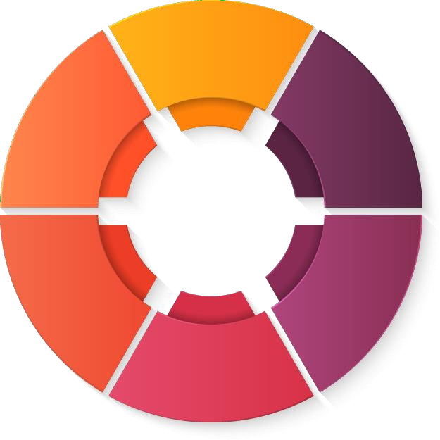

Capability To Arogya Setu – Tele Medicine Ecosystem Proposed for Ministry of Health, Uttarakhand
Therapeutic Drug Research
Predictive Virulence Modelling
Drug response and resistance
AI models for genomic analysis
Track and Trace
Pandemic Health management system
Body based Bluetooth Sensors to prevent violation
Proactive alerts to community
3rd Party citizen apps : Symptom collection
Track and trace: Community
Insurance
Education
Insurance
Insurance
Connect to Ayushmaan Bharat
Awareness, Assessment (Self) and Access
Digitalized education aids
Self assessment tools using chat-bots
Crowdsourcing public SOS SEWA (WhatsApp)
Aarogya Setu
Built on India Stack JAM
(Jandhan, Aadhar and
Mobility)
Integrated Supply Chain
Predictive Geo tracking
Pharmacy at your doorstep
Risk models
Integrated Supply Chain
Tele Health
Services
Tele Health
Crowdsource doctors
Emergency response
Digitization (Consultation, Triaging, Prescription)
Front
Line Tracking
Front Line Tracking
Network for frontline /casualty doctors
Quarantine Monitoring
Predictive geo based hos
Pandemic Models
Pandemic Forecast Models
Models for citizen movement
INTEGRATED HEALTH PLATFORM
WITH EMERGENCY RESPONSE

Slide 22
Medimaze proposal to Ministry of Health, Uttarakhand

Slide 23



